Slide 1
CSC 455: Database Processing for Large-Scale Analytics
Lecture 4
Alexander Rasin
College of CDM, DePaul University
October 8th, 2013

Slide 2
Tonight
SQL Queries
  Aggregation
  Joins, outer joins
Python
SQLite

Slide 3
UPDATE
UPDATE TABLE_NAME
SET Attribute = value
WHERE condition;
Sets Attribute to value in exactly those tuples that satisfy condition

Slide 4
UPDATE
UPDATE Store SET city= ’Bohston’ WHERE city = ‘Boston’;
  Updates Boston tuples to new spelling
UPDATE Store SET city= 'Boston' WHERE city LIKE 'B%ton';
  Set “Boston” spelling
  Includes “Boston”, “Bohston” and even “Brighton”

Slide 5
UPDATE
UPDATE Savings
SET Amount = Amount * 1.2
WHERE accountType = ‘CD’;
UPDATE Checking
SET Amount = Amount * 1.04
WHERE Amount > 50;

Slide 6
DELETE
DELETE FROM TABLE_NAME
WHERE condition;
Removes from the table exactly those tuples that satisfy condition

Slide 7
DELETE
DELETE FROM Store
WHERE City = ‘Boston’;
DELETE FROM Store
WHERE StoreID = 600;
DELETE FROM Transaction
WHERE TransID = 1;

Slide 8
SQL Queries
General form of a query:
SELECT list of attributes to report
FROM list of tables
[WHERE tuple condition]
[GROUP BY list of grouping attributes]
[HAVING group condition]
[ORDER BY list of ordering attributes]

Slide 9
SELECT FROM
SELECT list of attributes
FROM list of tables
SELECT gives which attributes to include
  give a single attribute, or a list
  * for all attributes
  DISTINCT will only report distinct tuples
FROM gives the source table(s)

Slide 10
WHERE
SELECT DISTINCT city
FROM store
WHERE state = ‘IL’ OR state = ‘ME’;
SELECT TDate, Amount
FROM Transaction
WHERE Amount > 40 AND Amount < 80;

Slide 11
WHERE
SELECT *
FROM Store
WHERE (state = ‘IL’ OR city = ‘Portland’) AND StoreID != 100;
SELECT TDate, Amount
FROM Transaction
WHERE (Amount >=20 AND Amount <35)
OR (Amount >100 AND Amount<= 120);
Notes:
3 Rows and

Slide 12
ORDER BY
ORDER BY list of ordering attributes
Tuples returned by the query are sorted by the first attribute in the list
Ties are broken by the second attribute, then the third, et cetera
Tuples are sorted in ascending order unless we put DESC in the query

Slide 13
ORDER BY
SELECT *
FROM Store
ORDER BY State;
SELECT *
FROM Store
ORDER BY State DESC, City;

Slide 14
ORDER BY
SELECT Amount, TDate, TransID
FROM Transaction
ORDER BY Amount;
SELECT TDate, Amount
FROM Transaction
WHERE Amount >=20
ORDER BY TDate, Amount;

Slide 15
Aggregate Functions
Given an attribute, these functions will collect their results from the values of that attribute in the set of returned tuples:
  COUNT: Number of tuples containing values
  SUM: Sum of the values
  AVG: Average of the values
  MIN: Smallest of the values
  MAX: Largest of the values

Slide 16
Aggregates: COUNT
SELECT COUNT(*)
FROM Store;
SELECT COUNT(State)
FROM Store;
SELECT COUNT(DISTINCT State)
FROM Store;

Slide 17
Aggregates: SUM
SELECT SUM(*)
FROM Transaction;
(Can’t do that!)
SELECT SUM(Amount)
FROM Transaction;
SELECT SUM(Amount)
FROM Transaction
WHERE Amount <= 20 or Amount >= 100;
Notes:
930 and 690

Slide 18
Aggregates: AVG
SELECT AVG(Amount)
FROM Transaction;
SELECT AVG(Amount)
FROM Transaction
WHERE date = to_date(’11-Oct-2011’);
SELECT SUM(Amount)/COUNT(Amount)
FROM Transaction;
Notes:
77.5 = AVG

Slide 19
GROUP BY
GROUP BY list of grouping attributes
We can combine the tuples returned by a query into sets based on the value of some attribute(s), and report aggregate value with aggregated information for each group
Once we group, we cannot look at the values in the individual tuples anymore…

Slide 20
Count Stores By State
SELECT COUNT(StoreID)
FROM Store;
SELECT COUNT(StoreID)
FROM Store
WHERE state = ‘IL’;
… WHERE state = ‘MA’;
… WHERE state = ‘ME’;

Slide 21
GROUP BY
SELECT state, COUNT(StoreID)
FROM Store
GROUP BY state;
SELECT state, COUNT(DISTINCT city)
FROM Store
GROUP BY state;
SELECT state, city, COUNT(StoreID)
FROM Store
GROUP BY state, city;

Slide 22
GROUP BY
SELECT TDate, SUM(Amount)
FROM Transaction
GROUP BY TDate;
SELECT StoreID, MAX(Amount)
FROM Transaction
GROUP BY StoreID;
SELECT StoreID, MAX(Amount)
FROM Transaction
GROUP BY StoreID
ORDER BY StoreID;

Slide 23
GROUP BY
SELECT StoreID, SUM(Amount)
FROM Transaction;
(Can’t do that!)
SELECT StoreID, 0.5*MIN(Amount), 1.5*MAX(Amount)
FROM Transaction
GROUP BY StoreID
ORDER BY StoreID DESC;
(Can explicitly say ASC, but that is always the default)

Slide 24
HAVING
HAVING group condition
Once tuples are grouped and some aggregate function is computed, we can choose to display the result for only those groups that satisfy the expression
Use the same comparisons and boolean operators as WHERE

Slide 25
HAVING
SELECT TDate, SUM(Amount)
FROM Transaction
WHERE SUM(Amount) > 200
GROUP BY TDate;
(Can’t do that!)
SELECT TDate, SUM(Amount)
FROM Transaction
GROUP BY TDate
HAVING SUM(Amount) > 200;

Slide 26
Order of Operations
In what order are these clauses applied?
  FROM: Chooses a table
  WHERE: Chooses a set of tuples
  GROUP BY: Partitions them into groups
  HAVING: Chooses some subset of the groups
  SELECT: Chooses what columns to display
  ORDER BY: Chooses the order to display them

Slide 27
Joins
Data that is distributed among different tables can be combined into a single set of tuples using different types of joins:
  Equi-join
  Natural join
  Inner join
  Outer join (left, right, full)

Slide 28
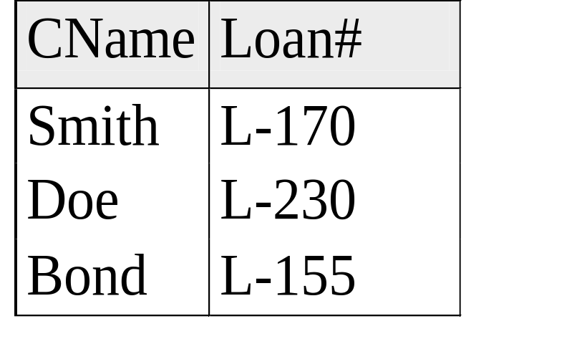
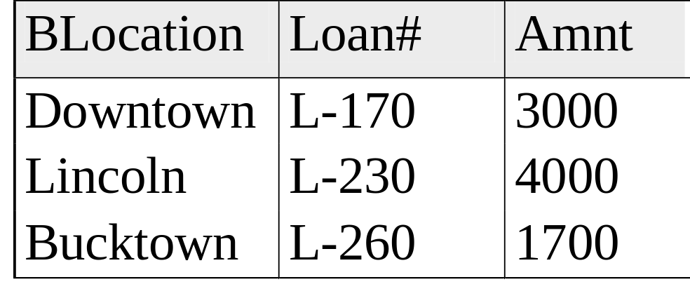
Customer and Bank Branch Data

Slide 29
Cartesian Product
What if we list two tables in FROM clause?
The tuples in the result come from combining all pairs of tuples from the two tables – Cartesian Product of the tables
This is probably more tuples than we want – most combinations are likely to be meaningless!

Slide 30
Cartesian Product
SELECT *
FROM customer, branch;
BLocation | Branch. Loan# | Amnt | Cname | Customer. Loan#
Downtown | L-170 | 3000 | Smith | L-170
Lincoln | L-230 | 4000 | Smith | L-170
Bucktown | L-260 | 1700 | Smith | L-170
Downtown | L-170 | 3000 | Doe | L-230
Lincoln | L-230 | 4000 | Doe | L-230
Bucktown | L-260 | 1700 | Doe | L-230
Downtown | L-170 | 3000 | Bond | L-155
Lincoln | L-230 | 4000 | Bond | L-155
Bucktown | L-260 | 1700 | Bond | L-155

Slide 31
Equi-Join
SELECT *
FROM branch, customer
WHERE customer.LoanNum = Branch.LoanNum;
BLocation | Customer. Loan# | Amnt | Cname | Branch. Loan#
Downtown | L-170 | 3000 | Smith | L-170
Lincoln | L-230 | 4000 | Doe | L-230

Slide 32
Natural Join
SELECT BLocation, customer.LoanNum, Amnt, CName
FROM customer, branch
WHERE customer.LoanNum = Branch.LoanNum;
BLocation | Customer. Loan# | Amnt | CName
Downtown | L-170 | 3000 | Smith
Lincoln | L-230 | 4000 | Doe

Slide 33
Inner Join
Both are inner joins, where the Cartesian Product is restricted to only include the combined tuples that satisfy some condition (typically agreement in some shared key)
Can replace list of tables in WHERE with:
… TABLE1 INNER JOIN TABLE2
ON condition;
instead of listing tables in FROM clause

Slide 34
Inner Join
SELECT BLocation, customer.LoanNum, Amnt, CName
FROM customer INNER JOIN branch
ON customer.LoanNum = branch.LoanNum;
BLocation | customer. Loan# | Amnt | CName
Downtown | L-170 | 3000 | Smith
Lincoln | L-230 | 4000 | Doe

Slide 35
Inner Join vs. Outer Join
An inner join requires that tuples in the tables match in the specified attribute to create a tuple in the result.
An outer join does not: a tuple in the result may be either
  the combination of two tuples that match in the specified attribute (matching tuple)
  a tuple that does not match anything, combined with an all-NULL tuple (non-matching tuple)

Slide 36
Left Outer Join
Includes all matching tuples, plus a tuple for each tuple in the first table that has no match
SELECT …
TABLE1 LEFT OUTER JOIN TABLE2
ON TABLE1.Attribute = TABLE2.Attribute;

Slide 37
Left Outer Join
SELECT *
FROM customer LEFT OUTER JOIN branch ON customer.LoanNum = branch.LoanNum;
BLocation | Customer. Loan# | Amnt | Cname | Branch. Loan#
Downtown | L-170 | 3000 | Smith | L-170
Lincoln | L-230 | 4000 | Doe | L-230
NULL | L-155 | NULL | Bond | NULL

Slide 38
Right Outer Join
Includes all matching tuples, plus a tuple for each tuple in the second table that has no match
SELECT …
TABLE1 RIGHT OUTER JOIN TABLE2
ON TABLE1.Attribute = TABLE2.Attribute;

Slide 39
Right Outer Join
SELECT *
FROM customer RIGHT OUTER JOIN branch ON customer.LoanNum = branch.LoanNum;
BLocation | Customer. Loan# | Amnt | Cname | Branch. Loan#
Downtown | L-170 | 3000 | Smith | L-170
Lincoln | L-230 | 4000 | Doe | L-230
Bucktown | NULL | 1700 | NULL | L-260

Slide 40
Full Outer Join
Includes all matching tuples, plus a tuple for each tuple in either table that has no match
SELECT …
TABLE1 FULL OUTER JOIN TABLE2
ON TABLE1.Attribute = TABLE2.Attribute;

Slide 41
Full Outer Join
SELECT *
FROM customer FULL OUTER JOIN branch ON customer.LoanNum = branch.LoanNum;
BLocation | Customer. Loan# | Amnt | Cname | Branch. Loan#
Downtown | L-170 | 3000 | Smith | L-170
Lincoln | L-230 | 4000 | Doe | L-230
NULL | L-155 | NULL | Bond | NULL
Bucktown | NULL | 1700 | NULL | L-260

Slide 42

BREAK

Slide 43
Student Data
COURSE
  ‘CSC211’, ‘Intro to Java I’, 4
  ‘IT130’, ‘The Internet and the Web’, 2
  ‘CSC451’, ‘Database Design’, 4
STUDENTS
  ‘12345’, ‘Paul K’, ‘Grad’
  ‘23456’, ‘Larry P’, ‘Grad’
  ‘34567’, ‘Ana B’, ‘Ugrad’
  ‘45678’, ‘Mary Y’, ‘Grad’
  ‘56789’, ‘Pat B’, ‘Ugrad’

Slide 44
Student Data
ENROLLMENT
  ‘12345’, ‘CSC211’, ’01-Jan-2011’
  ‘12345’, ‘CSC451’, ’02-Jan-2011’
  ‘23456’, ‘IT130’, ’03-Jan-2011’
  ‘34567’, ‘CSC211’, ’06-Jan-2011’
  ‘34567’, ‘IT130’, ’07-Jan-2011’
  ‘34567’, ‘CSC451’, ‘11-Jan-2011’
  ‘45678’, ‘IT130’, ’02-Jan-2011’
  ‘45678’, ‘CSC451’, ’02-Jan-2011’

Slide 45
Example Queries
Which courses are offered?
  SELECT Name
  FROM Course;
How many ugrad students are enrolled?
  SELECT COUNT(*)
  FROM Student
  WHERE Standing = ‘Ugrad’;

Slide 46
Example Queries
What is the total number of credits?
  SELECT SUM(Credits)
  FROM Course;
What’s the grad/ugrad breakdown?
  SELECT Standing, COUNT(*)
  FROM Student
  GROUP BY Standing;

Slide 47
Example Queries
Compute the number of courses for each student that’s enrolled in more than 2 courses
  SELECT Name, COUNT(CourseID)
  FROM Student, Enrollment
  WHERE Student.ID = StudentID
  GROUP BY Name
  HAVING COUNT(CourseID)>=2;

Slide 48
Example Queries
Find all students that are not currently taking any courses:
  SELECT Name, COUNT(CourseID)
  FROM Student, Enrollment
  WHERE Student.ID = StudentID
  GROUP BY Name
  HAVING COUNT(CourseID)=0;
Not going to work!

Slide 49
Example Queries
Need to find the tuples absent from join
  i.e. OUTER JOIN
Find all students that are not currently taking any courses:
  SELECT Name
  FROM Student LEFT OUTER JOIN Enrollment
  ON (Student.ID = StudentID)
  WHERE CourseID IS NULL;

Slide 50
Example Queries
List all courses IDs and the number of students enrolled
  SELECT Course.CourseID, Count(StudentID)
  FROM Course, Enrollment
  WHERE Course.CourseID = Enrollment.CourseID
  GROUP BY Course.CourseID;

Slide 51
Example Queries
List all course names and the number of students enrolled, ordered by popularity
  SELECT Name, Count(StudentID) as Enrolled
  FROM Course, Enrollment
  WHERE Course.CourseID = Enrollment.CourseID
  GROUP BY Name
  ORDER BY Enrolled DESC;

Slide 52
Example Queries
List students and the course names they are enrolled in
  SELECT Student.Name, Course.Name
  FROM Course, Enrollment, Course
  WHERE Student.ID = Enrollment.StudentID AND Enrollment.CourseID = Course.CourseID
  ORDER BY Student.Name;

Slide 53
SQL Practice
Select student names and first enrollment date
Select course names and ids of enrolled students – include empty courses in the result
List student names and number of enrollments they have, ordered by name (reverse alph.)
List the students (names and ID) with the number of courses each student is enrolled in. Be sure to include students who are not enrolled in any courses

Slide 54
Nested Queries (Subqueries)
The result of one query may be needed by another to compute its result:
  One query (the nested query or subquery) is nested within another (the outer query)
  Outer query uses the result of the nested query, which can be either a table or a single value
Nested query usually appears in a WHERE or HAVING clause (rarely, a FROM)

Slide 55
Uses of Nested Queries
“Find all students who got the highest score on the exam. (Find the highest score)”
“Find IDs of all course sections being taken by Jane Doe”. (Find her StudentID)
“Find IDs of all students who are taking some course with Student X this quarter.” (Find all courses being taken by X)

Slide 56
Nested Queries Syntax
Must always appear within parentheses
Can only appear on the right-hand side of a comparison
SELECT can only specify a single attribute unless using IN or EXISTS
Attribute names refer to tables in FROM clause of the nested query (unless qualified)
Cannot use ORDER BY

Slide 57
Returning a Single Value
When a single value is returned, it can be used like any other value in a WHERE or HAVING condition
Ex: SELECT * FROM ASSIGNMENT
WHERE Hours >
(SELECT AVG(Hours) FROM ASSIGNMENT);

Slide 58
Returning a Table
Check whether subquery result is empty:
  EXISTS (query) will return true if result of nested query is not empty
  NOT EXISTS (query) will do the opposite
Check contents of table:
  tuple IN (query) returns true if tuple appears in result table

Slide 59
Returning a Table
Compare value to table contents (if unary):
  value > ALL (query) returns true if value is greater than all values in table
  value > ANY (query) returns true if values is greater than any value in table
  Any type of comparison is allowed, not just >

Slide 60
Correlated Nested Queries
Nested query may refer to attributes of the table(s) given in the outer query
  These must be qualified with table name(s)
  Nested query will be evaluated repeatedly, once for each tuple in the table in the outer query
  Have to rename table in outer query if it is also referenced in nested query

Slide 61
Python and SQLite
c.execute(CT)
c.execute("INSERT INTO Course VALUES ('CSC451', 'Database Design', 4);");
Float → REAL datatype
VARCHAR2 → VARCHAR
DATE → TEXT datatype

Slide 62
Python Print
print is your friend
Debug your code line-by-line
import sqlite3
conn = sqlite3.connect('csc455.db')
c = conn.cursor()
c.execute(“SELECT * FROM Table”).fetchall()

Slide 63
Python Use
fd = open('data_hw2.txt')
contents = fd.read()
fd.close()
oneLine = fd.readline()
lineArray = fd.readlines()

Slide 64
Python Use
for elt in lineArray:
print elt
for elt in lineArray:
stringSplit = elt.split(', ')
print stringSplit

Slide 65
Python Use
for elt in lineArray:
cleanElt = elt.strip()
stringSplit = cleanElt.split(', ')
print stringSplit
Other ways to clean up
  newString = elt[:-1]
  newString = elt.replace('\n', '')

Slide 66
Python Use
for elt in lineArray:
currentRow = elt[:-1].split(", ")
insert = """insert into myTable values ('%s', %s, %s)""" %(currentRow[3], currentRow[4], currentRow[5])
print insert
}
c.execute(insert)

Slide 67
Python Use
TDict1 = {}
for elt in lineArray:
currentRow = elt[:-1].split(", ")
if not TDict1.has_key(currentRow[3]):
TDict1[currentRow[3]] = [currentRow[3:5]]

Slide 68
Next Time:
Even more SQL queries
Midterm review
Guest lecture
(Assignment 3 posted in a couple of days)

